Slide 1

Image processing & analysis
SADL – Evert Van Bever
KU Leuven

Slide 2
Table of content
Satellite sensors
Image visualisation
Spectral signature
Derived indices
Image classification techniques

Slide 3
Learning objectives
At the end of the course participants should be able to:
Explain how satellite image bands represent different information
Explain what a true and false colour composite is
Explain raster calculation & vegetation indices like NDVI
Understand the different steps of image processing
Explain the relevance of spectral signatures for image classification
Relate multispectral imagery to real-world applications

Slide 4
Satellite sensors
1
Notes:
Before can go to the image processing itself, it is important to know what exactly is being processed.

Slide 5
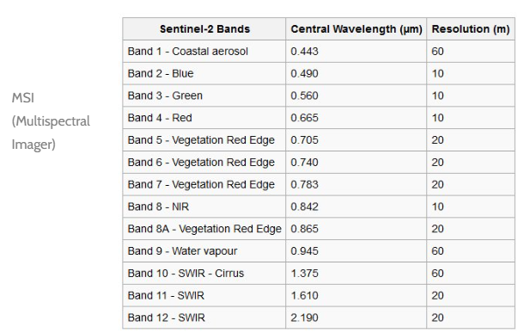
Sensor characteristics
E.g. Sentinel-2A Satellite Sensor (10m)
Determines possibilities for analysis:
RGB
Multispectral: collect data throughout a limited portion of the electromagnetic spectrum (five to ten bands); typically, it’s RGB (red, green, and blue — the three primary colors) and a handful of infrared bands
Hyperspectral: satellites can distinguish thousands of individual light spectrum bands
Satellite Imaging Corporation, n.d.
Notes:
A satellite has different sensors on board to detect information from earth. The type of detected data influences the possibilities for analysis.
There are three main types of satellite images.
RGB: detecting the primary colors of the EMS Red Green Blue
A multispectral satellite measures the amount of reflected EMS waves in RGB and some infrared bands. Usually, it is a rage of 5-10 bands.
And then there is the most ‘advanced’ type of satellite, the one that makes hyperspectral images. It distinguishes between thousands of individual light spectrums bands.
Sources:
EOS. (2021, September 8). Multispectral vs. hyperspectral imaging. EOS. https://eos.com/blog/multispectral-vs-hyperspectral-imaging/
Satellite Imaging Corporation. (n.d.). Sentinel-2A. Satellite Imaging Corporation. https://www.satimagingcorp.com/satellite-sensors/other-satellite-sensors/sentinel-2a/

Slide 6
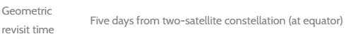
Sensor characteristics
E.g. Sentinel-2A Satellite Sensor (10m)
- Change detection
Notes:
Another thing one has to keep in mind is the spatial resolution and in case if the intend to do change detection mapping the revisit time of the satellite.
Satellite Imaging Corporation. (n.d.). Sentinel-2A. Satellite Imaging Corporation. https://www.satimagingcorp.com/satellite-sensors/other-satellite-sensors/sentinel-2a/

Slide 7
Image visualisation
2
Notes:
There are different ways to visualize images.

Slide 8
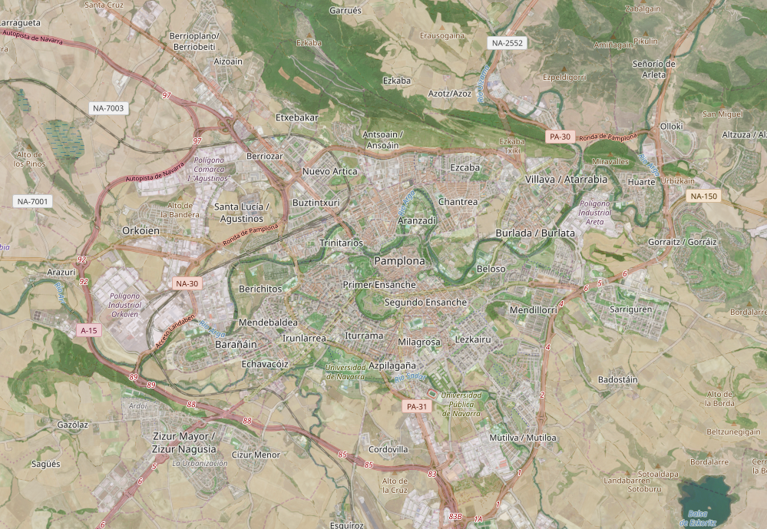
True colour
Copernicus Browser
Notes:
This is a true color image.

Slide 9
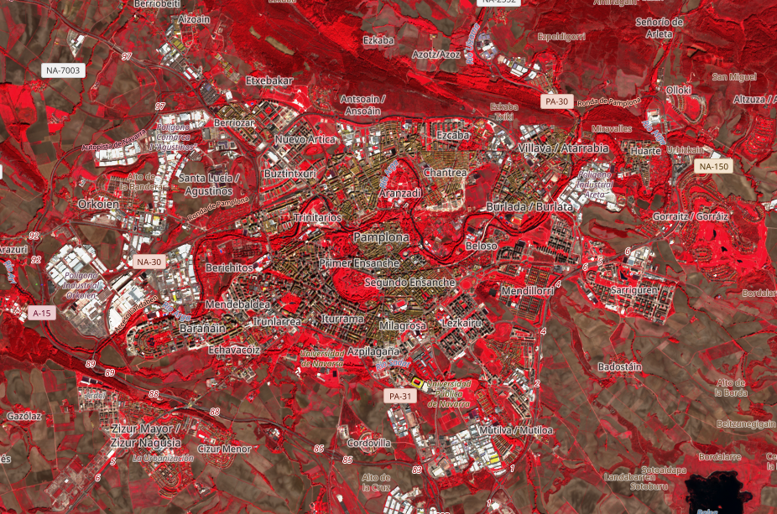
False colour
Copernicus Browser
Notes:
This is a false color image.

Slide 10
Spectral signature
3
Notes:
What was the spectral signature again.

Slide 11
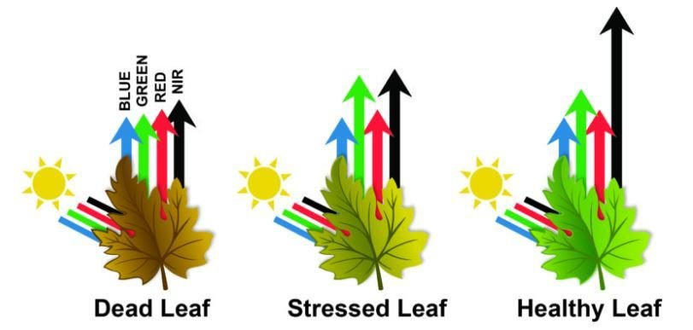
Reflection of electromagnetic waves
Radiation can be absorbed by a target, transmitted through a target or reflected. The proportion of each depends on the wavelength and surface features.
Notes:
Materials absorb and reflect a certain amount of each incoming EM radiation.
The amount that is reflected for each wavelength is detected by the satellite.

Slide 12
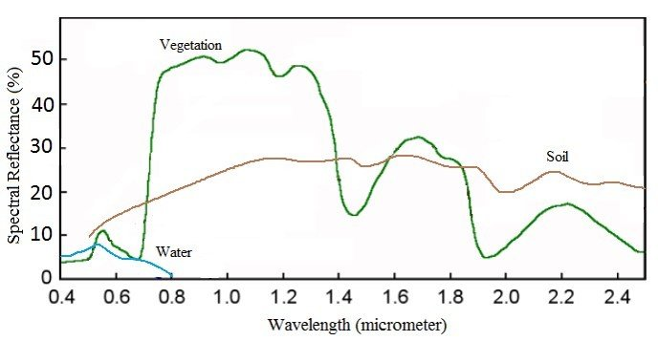
Spectral reflectance curve
Spectral signature
Spectral Reflectance is the amount of energy reflected from a surface at a specific wavelength.
Analysis of the spectral reflectance signatures
allows to distinguish different surface feature
or materials.
Spectral reflectance curve presents the
reflectance of objects as a function of wavelengths.
Notes:
The amount of reflected energy for each wavelength plotted gives a curve that is specific for each material. Called the spectral reflectance curve, or spectral signature.

Slide 13
Derived indices
4
Notes:
DERIVING REMOTE SENSING INDICES FROM SENTINEL 2 SATELLITE IMAGERY IN GOOGLE EARTH ENGINE | by LAWRENCE KIMUTAI | Medium

Slide 14
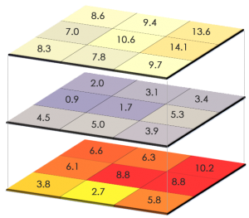
Raster calculations
Each band can be seen as an individual raster layer
A layer can be edited by a mathematical operation
+, -, x, :
A number
Another layer
Notes:
Vector vs Raster in GIS: What's the Difference? - GIS Geography

Slide 15
Derived indices
Produce 1 indices that indicates information about a specific characteristic
Combines different bands, raster calculations
Examples:
NDVI (Normalized Difference Vegetation Index)
NDWI (Normalized Difference Water Index)
EVI (Enhanced Vegetation Index)
GCI (Green Chlorophyll Index)
NDBI (Normalized Difference Built-Up Index)
…
Notes:
Different bands each can tell something about the surface. However, it is not always easy if you then want to combine knowledge from one band with another, if they both tell something about the same characteristics.
That is where indices come into play. They combine this information of other bands into one layer.
There are multiple examples and some will be looked at in more dept.

Slide 16

NDVI
Normalized Difference Vegetation Index
the greenness and the density of the vegetation captured in a satellite image
Healthy vegetation has a very characteristic spectral reflectance curve which we can benefit from by calculating the difference between two bands – visible red and near-infrared
Notes:
A first, and well-known index is the NDVI: Normalized Difference Vegetation Index.
This combines the characteristics of healthy plants reflecting NIR.

Slide 17

NDVI
Normalized Difference Vegetation Index
$$NDVI=\frac{NIR −RED}{NIR+RED}$$
NIR – light reflected in the near-infrared spectrum
RED – light reflected in the red range of the spectrum
values ​​from -1.0 to 1.0: (indications)
negative values: mainly formed from clouds, water and snow
​close to 0: primarily formed from rocks and bare soil
small values ​​( <= 0.1): empty areas of rocks, sand or snow
moderate values ​​(0.2 - 0.3): shrubs and meadows
Large values ​(0.6 - 0.8): temperate and tropical forests
Notes:
The NDVI used the amount of reflected red and near-infrared to measure plants.
Normalised stands for the value being limited in a range between -1 till 0.
Each value range has a meaning, as can be seen in the slide.
https://eos.com/make-an-analysis/ndvi/

Slide 18
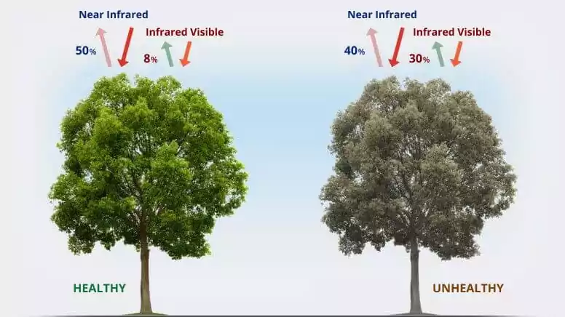

NDVI
$$NDVI=\frac{NIR −RED}{NIR+RED}$$
Normalized Difference Vegetation Index
Chlorophyll (a health indicator pigment) strongly absorbs visible light, and the cellular structure of the leaves strongly reflects near-infrared light.
When the plant becomes dehydrated, sick, afflicted with disease, etc., the spongy layer deteriorates, and the plant absorbs more of the near-infrared light, rather than reflecting it.
Thus, observing how NIR changes compared to red light provides an accurate indication of the presence of chlorophyll, which correlates with plant health.
EOS, n.d
Notes:
This slide gives a more detailed story on why certain ranges are reflected more when plants are healthy.
EOS. (n.d.). NDVI: Normalized difference vegetation index. EOS. https://eos.com/make-an-analysis/ndvi/

Slide 19
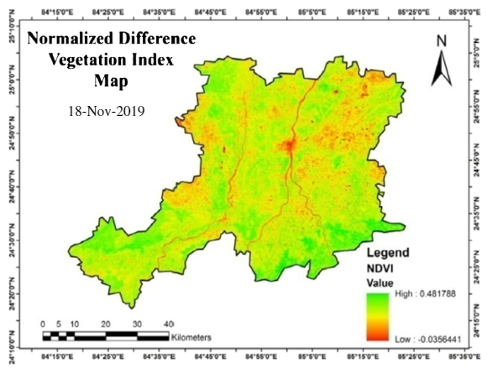
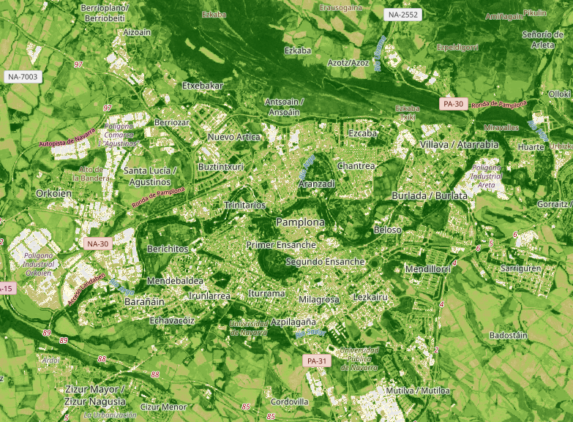
NDVI
Normalized Difference Vegetation Index
Notes:
examples: right is Evreux
https://eos.com/make-an-analysis/ndvi/

Slide 20

NDBI
Normalized Difference Built-Up Index
highlights urban areas where there is typically a higher reflectance in the shortwave-infrared (SWIR) region, compared to the near-infrared (NIR) region
Applications; watershed runoff predictions, land-use planning, …
An urban area or built-up area reflects more short-wave infrared (SWIR) than near-infrared (NIR) as similar as bare soil
separates the built-up land from barren and bare areas to some extent
Value from −1.0 to +1.0:
Negative values: suggest waterbodies
values near zero: vegetated areas
value approaching to +1: urban area shows the high value
$$NDBI= \frac{SWIR −NIR}{SWIR+NIR}$$
Notes:
Another interesting index is the NDBI: Normalized Difference Built-Up Index
Urban areas will have values +1. this is due to the use of short-wave infrared that is more reflected than near infrared. More info in the slides.
NV5 Geospatial Software. (n.d.). Background on other indices. NV5 Geospatial Software. https://www.nv5geospatialsoftware.com/docs/BackgroundOtherIndices.html
(6) (PDF) Land surface temperature retrieval from TIRS data and its relationship with land surface indices (researchgate.net)

Slide 21
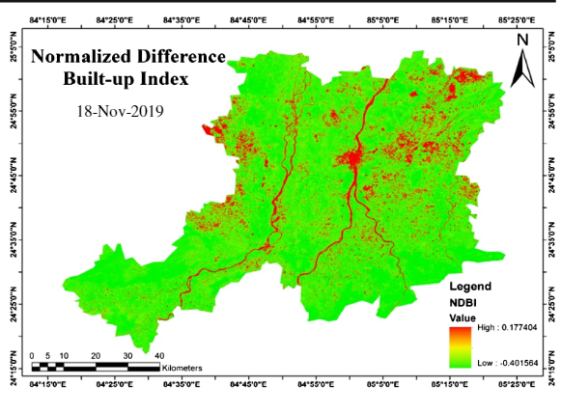
NDBI
Normalized Difference Built-Up Index
Notes:
Omar, P. J., & Kumar, V. (2021). Land surface temperature retrieval from TIRS data and its relationship with land surface indices. Saudi Society for Geosciences. https://www.researchgate.net/publication/354288285_Land_surface_temperature_retrieval_from_TIRS_data_and_its_relationship_with_land_surface_indices

Slide 22
Image classification techniques
5
Notes:
Previous parts are mainly on some (small) image analysis methods. Now the focus will be more on while image classifications. Or in practice thus cell classification.

Slide 23
Classification techniques
Context of RS: assigning a class to each pixel
4 main types of image classification techniques in remote sensing are:
Unsupervised image classification
Supervised image classification
Object-based image analysis
Deep learning object detection
Low spatial resolution images: both traditional & object-based classification works well
High spatial resolution images: OBIA superior
Notes:
In the context of RS classification techniques are about assigning a class to each and every pixel.
There are 4 main types of image classification techniques one can use in RS. They are mentioned on the slides.
Important to know is that not al methods work on all resolution image. For the more object based image processing techniques higher resolution pictures are needed.
GISGeography. (n.d.). Image classification techniques in remote sensing. GISGeography. https://gisgeography.com/image-classification-techniques-remote-sensing/

Slide 24
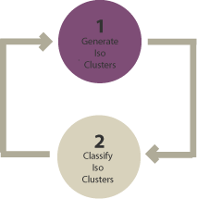
Unsupervised classification
How?
Groups pixels into “clusters” based on their properties [Generate clusters]
You classify each cluster with a land cover class [Assign classes]
Most basic technique
image clustering algorithms
K-means
ISODATA
Clusters determined by user:
More clusters = less variability within one, but more between classes.
Notes:
A first method is unsupervised classification, where the method will cluster similar pixels or cluster pixels based on properties.
When that step is done the user has to classify the cluster with a correct cover.
One should not that this is the most basic technique, with only clustering and the user still having to decide what a pixel is.
There are different statistical algorithms that cluster. In this case the user choses the amount of cluster. A general thing to know is that:
Less clusters means more variability within a cluster or the other way around. So to get a more precise result more clusters are needed, but this also means more manual labeling for you as user.

Slide 25
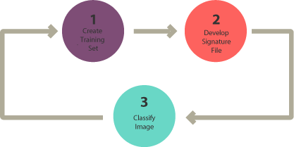
Supervised classification
3 basic steps:
Select training areas/sites/samples : select representative samples for each land cover class
Generate signature file
Classify
For each land cover class, you continue creating training samples
until you have representative samples for each class.
In turn, this would generate a signature file, which stores all training samples’ spectral information.
Notes:
The second method is supervised classification. Here you as a user select some areas/ sites (= pixels) that represent a certain land cover class.
Then a signature file is created, based on the previously mentioned spectral signature curves. This is then used to classify the other pixels automatically.
This implies that you must create these so-called training classes for each different land cover. If not a pixel will be classified in what is the closest one you used for training.
This method will thus mostly rely on your input.

Slide 26
Supervised classification
Spectral information (signature) used to classify other pixels.
Different algorithms:
Maximum likelihood
Minimum-distance
Principal components
Support vector machine (SVM)
Iso cluster
→ Test them
Notes:
There are again some different algorithm used to classify pixels, looking at what signature curve the pixels matches with the most.
The different algorithms can be read up on if you want more insight into them. If you do not have the insight, trying them and comparing them is also a great ways

Slide 27
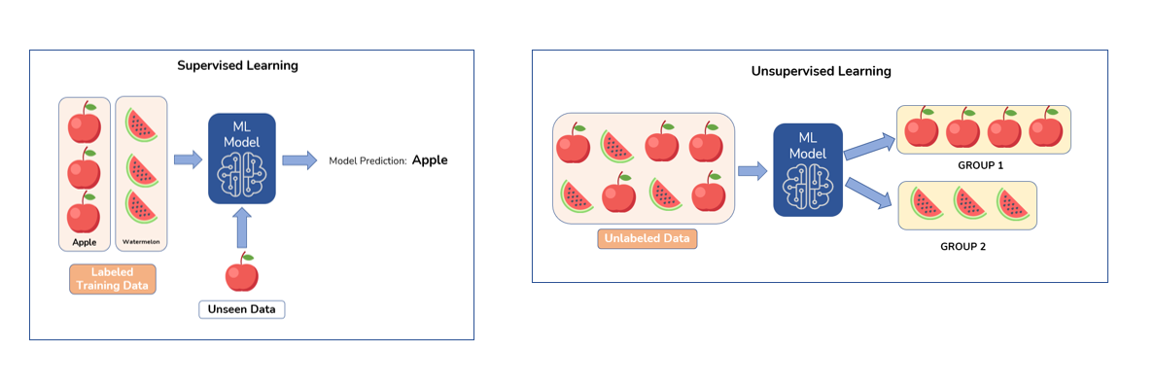
Unsupervised classification vs Supervised classification
Devashree, 2022
Notes:
This image shows the difference between a supervised an unsupervised classification method.
Labeling the data before or after the ML model is the main difference.
It might now seem in this picture one is beter than the other, but each has it benefits.
e.g. if the supervised method only uses the colors from the input it could struggle if a fully green apple is used as unseen data. Or if a whole watermelon was used in the unsupervised method it could say it looks the same as the apple if the ML only looks at shape.
Devashree. (2022, September 1). Unsupervised learning in image classification. AmyGB. https://www.amygb.ai/blog/unsupervised-learning-in-image-classification

Slide 28
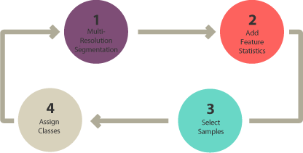
Object-based image analysis
Supervised & unsupervised = pixel-based classification
<>
Object-based: groups pixels into shapes (vector: size & geometry)
Steps:
Perform multiresolution segmentation (groups pixels)
Select training areas
Define statistics
Classify
Notes:
A method that does not use a pixel-based approach is object-based image analysis.
This does not classify based only on pixels but takes full shapes into account. To make the link with vector data: the size and geometry.
In the first step a multiresolution segmentation takes place, this means grouping pixels. Then some training areas are selected, and a statistical model is trained over it.
After that all others are classified.

Slide 29
Object-based image analysis
Segmentation: if objects are very clear it can be done by software
Segmentation methods:
Multi-resolution segmentation
Segmentation mean shift
Notes:
Because the method uses objects, one should use clear images for this, in non clear images the objects might be absorbed in a pixel.
There are a couple of segmentation methods mentioned.
Image Classification Techniques in Remote Sensing (gisgeography.com)

Slide 30
Object-based image analysis
Classification methods:
Shape e.g. rectangle ≈ building
Texture: homogeneity e.g. water
Spectral: mean values R, G, B, NIR, SWIR
Geographic context: proximity & distance relationship neighbours
Nearest neighbour classification: similar supervised classification
Multi-resolution segmentation
User identifies sample sites
Statistics for objects
NN classifies objects based on previous
Notes:
The way to classify something into one object can be done with multiple methods/ characteristics.
GISGeography. (n.d.). Image classification techniques in remote sensing. GISGeography. https://gisgeography.com/image-classification-techniques-remote-sensing/

Slide 31
Deep learning object detection
Form of AI
Fast growing
Learn from large datasets
Notes:
A last method is deep learning, this is a form of AI that combines a lot of methods that is quickly growing and often used if you have a lot of images.

